Slide 1
What Prevention and Treatment of Substance Use Disorder Can Tell Us About Addressing Violent Extremism
Ryan A. Brown, Rajeev Ramchand, and Todd C. Helmus
University of Texas, 11 August 2022
Notes:
Follow-on to report on research conducted for NIJ. Grateful to RAND donor Ellen Hancock for funding this and our time today.

Slide 2
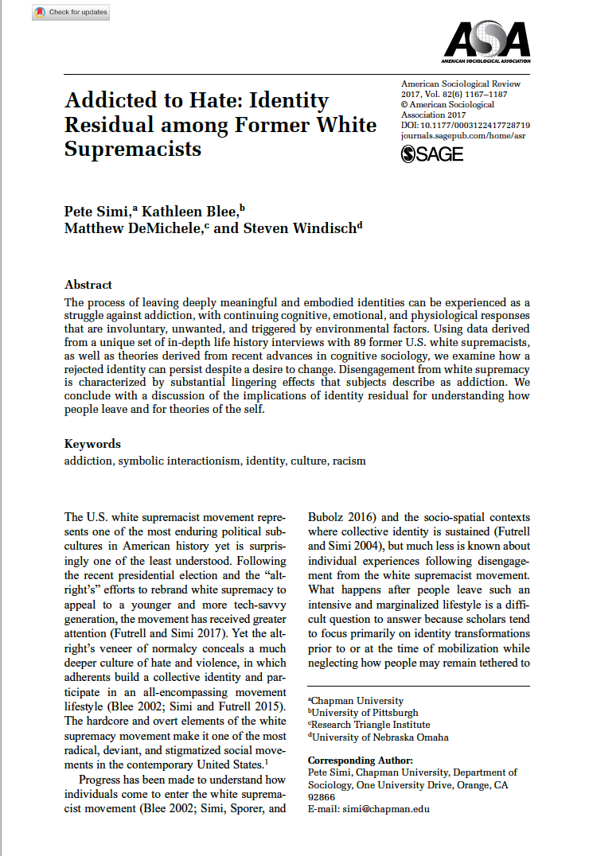
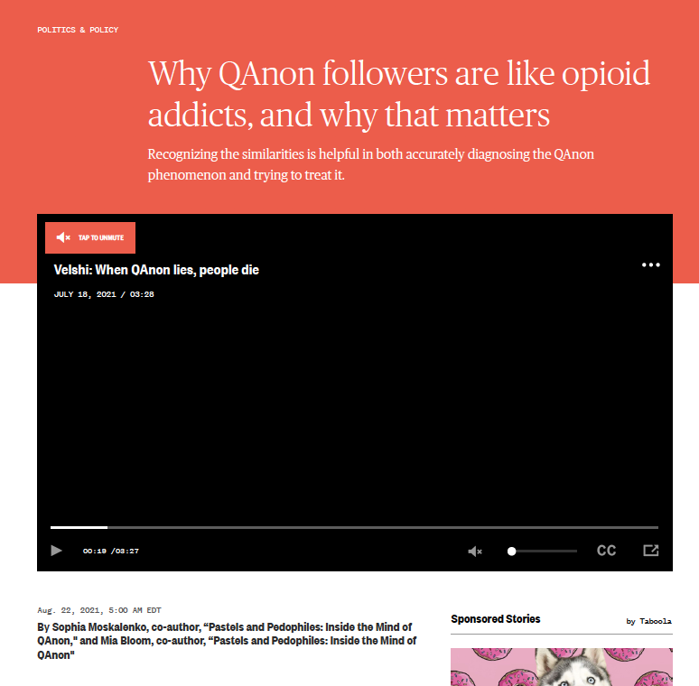
Can One Be Addicted to Extremism?
We review the various similarities between drug dependence and extremism and identify some potential lessons learned
Notes:
We are not the first to notice the overlap between extremism and addiction. We reviewed our data and the existing literature to see what we could learn about the scientific evidence base and implications for policy and practice.

Slide 3
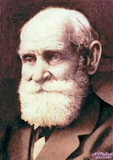
Conditioned Cues
Cues associated with drug self-administration can trigger cravings and relapse to drug use
Some reformed extremists also report that cues can lead to the reexperience of extremist ideology or re-engagement with extremist activities
Ivan Pavlov
Notes:
BASIC POINT IS THAT THE CONTEXTAL FEATURES AROUND DRUG USE AND EXTREMISM TRIGGER CRAVINGS AND DRIVE TO RE-ENGAGE WITH THOSE BEHAVIORS [SEE EXTREMISM EXAMPLES]
--Non-human and human studies of addiction to substances shows how stimuli associated with the reward later trigger cravings and drive to consume substances (Pavlovian effect)
--Similarly, reformed extremists report experiencing the “itch” to re-engage with street violence or other extremist activities while watching protests, street battles between Right and Left-wing groups, or seeing symbols associated with extremist groups:
“I can’t watch like the old war movies or like say Inglorious Bastards or, or something like that, you know, and they show like a, or like a, the History Channel has the World War II in HD and they, you know, even though they’re showing the Germans getting slaughtered and stuff, I still see that, that, you know, the swastika in the background, you know. I get a little goose bumps. I can’t lie, you know. (Interview, June 26, 2015)”*
*Simi, P., Blee, K., DeMichele, M., & Windisch, S. (2017). Addicted to hate: Identity residual among former white supremacists. American Sociological Review, 82(6), 1167-1187.

Slide 4
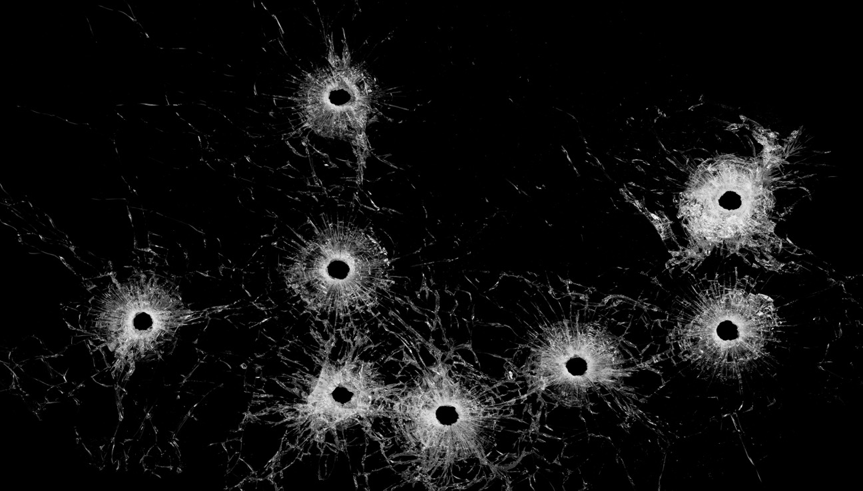
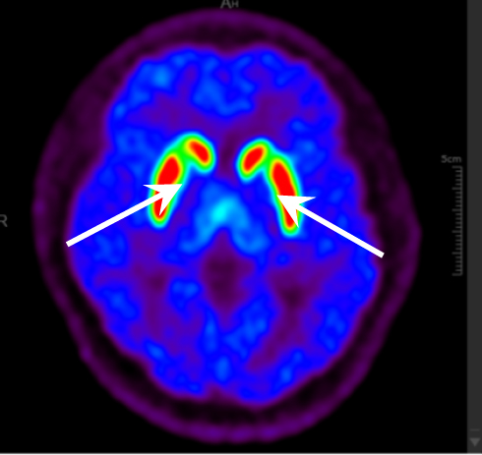
Neurobiology of Vengeance
Dopaminergic pathways play a critical role in the reinforcement of psychoactive drugs such as cocaine or opiates
Research suggests that the desire for revenge in response to grievances activates the same reward pathways
This Photo by Unknown Author is licensed under CC BY-SA-NC
Notes:
REWARD PATHWAYS – WITH HABITUATION THE DRIVE CAN BECOME DISSOCIATED FROM THE EXPERIENCE OF REWARD – ADDICTION TO GRIEVANCE ITSELF
--fMRI studies link retaliatory aggression (both personal history and laboratory behavior) with differential activation of nucleus accumbens and other areas of the brain associated with reward and experiences of hedonic pleasure, as well as appetitive drive*
--Prefrontal cortex (self-regulation) acts to downregulate aggression
--Reward may initially be coupled with seeing target of vengeance suffer, but can also become decoupled from that experience – such that engagement with hateful symbols and extremist content creates the same pleasure and drive**
--Suggests that experiencing grievances itself may be addictive
*David S. Chester, C. Nathan DeWall, The pleasure of revenge: retaliatory aggression arises from a neural imbalance toward reward, Social Cognitive and Affective Neuroscience, Volume 11, Issue 7, July 2016, Pages 1173–1182
**Stahl, Stephen M., "Is Impulsive Violence an Addiction? The Habit Hypothesis," CNS Spectrums, Vol. 20, No. 3, June 2015, pp. 165–169

Slide 5
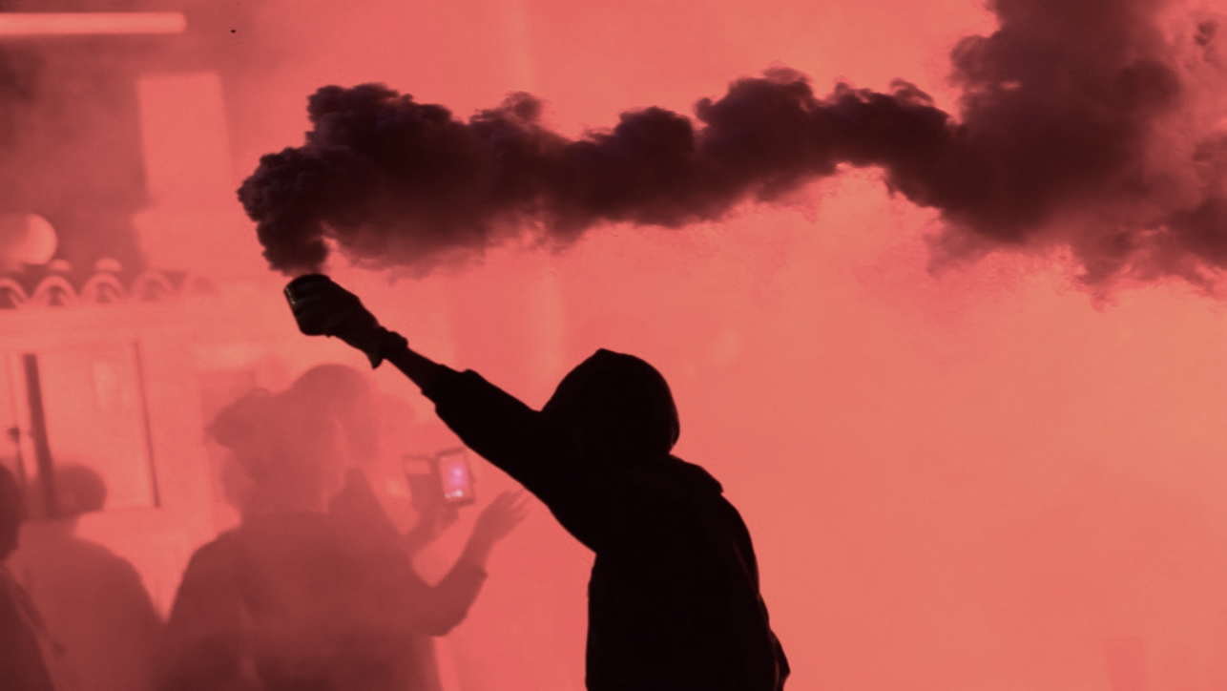
Role of Stress in Relapse
Both animal models and human research suggest that exposure to stress can re-trigger drug seeking behavior
Anecdotal accounts suggest that stress may also lead former extremists to lapse back into old ways of thinking of acting
This Photo by Unknown Author is licensed under CC BY-SA-NC
Notes:
--Stressful life events trigger of relapse to substance addiction, likely because of the temporary emotional regulation that results*
--Similarly, anecdotal accounts from former extremists indicates that stressful life situations can create a craving or actual engagement in extremist behavior:
I go through the drive-thru and what’d they do? They fucked up [my son’s] order and they didn’t give me tacos or I don’t know. So I go back in there and his burger’s like tiny. I’m like, I’m like, “That burger was $5.00, why is this little?” Okay, well, the lady, she was, they’re all Mexican. They hardly speak English and she’s like accusing me of coming back for free food and I got pissed off and she was like ignoring me, like and I’m trying to talk to her and, and she wouldn’t listen to me and is talking to other people and accusing me of, “I put them in your,” “No, you didn’t. I wouldn’t drive all the way back here if you gave me my food.” I’m like, “You didn’t give me this, this, and this.” And so I don’t remember what she said because I barely understood her. She wouldn’t give me her name, you know. She wouldn’t stand close enough where I could see the, her thing, and she wouldn’t tell me, I asked for the manager. “Oh, there’s no manager.” She was really rude and so I told her, “Fuck you, you fucking Beaner, get the fuck out of my country,” and I told her, “White power,” and I walked out and I threw a heil up [Nazi salute] and I don’t usually do that shit anymore but I was so angry and it’s because of everything that’s going on now. . . . I did it as I was walking out. . . . I don’t even remember everything I said. I was so angry. . . . No, all I saw was red and I saw her and I wanted to fucking beat the piss out of her. (Interview, July 20, 2015)**
*Sinha, Rajita, "The Role of Stress in Addiction Relapse," Current Psychiatry Reports, Vol. 9, No. 5, October 2007, pp. 388–395.
*Simi, P., Blee, K., DeMichele, M., & Windisch, S. (2017). Addicted to hate: Identity residual among former white supremacists. American Sociological Review, 82(6), 1167-1187.

Slide 6
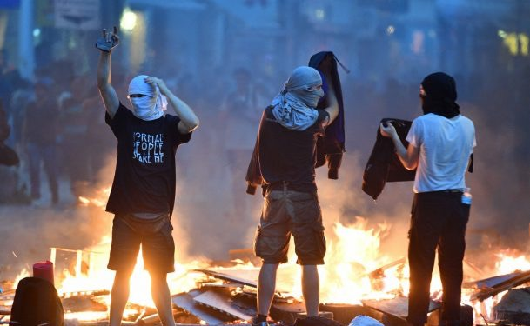
Features of Chronic Disease
Like individuals with substance use disorders, individuals who have deradicalized report feeling pulled or drawn back to violent extremism years or even decades – beyond their involvement with extremist groups
This Photo by Unknown Author is licensed under CC BY-SA
Notes:
--Substance addiction and behavioral addictions (gambling, sex, etc.) are life-long struggles with periods of relapse, and often get progressively worse without treatment and support
--Accounts from former extremists reveal a similar pattern, with both aggressive intervention (often over years) and maintenance of “hate sobriety” through supportive networks necessary

Slide 7
Psychiatric Comorbidity
Substance use disorder populations have high rates of mental health problems: Half of those with a non-alcoholic drug problems have a lifetime mental health disorder
Several studies also show high rates of mental health problems among current/former extremists
This Photo by Unknown Author is licensed under CC BY-SA-NC
Notes:
--OVERLAP WITH MENTAL ILLNESS, AND WITH SUBSTANCE USE ITSELF – BOTH ARE NOT PREDICTIVE, BUT SENSITIVE POINTS
--Substance addiction has a high rate of mental illness comorbidity
--Like other forms of addiction, extremism overlaps with mental health issues at a surprisingly high rate (~50%)
--Rates of substance use issues in extremists appear often reported at 50% or higher*
--Perhaps due to wanting to avoid stigmatizing mental health and substance addiction – or not wanting to “excuse” extremism – this pattern has been underreported in extremism literature until recently
*Bubolz, Bryan F., and Pete Simi, "The Problem of Overgeneralization: The Case of Mental Health Problems and U.S. Violent White Supremacists," American Behavioral Scientist, 2019.

Slide 8
Social Relationships
Relationships with drug users can lead people to initiate drug use; The deepening of such relationships helps maintain drug use
Same issues play out in violent extremism: Radicalization is a social act and extremists form close knit bonds
This Photo by Unknown Author is licensed under CC BY-SA-NC
Notes:
--SOCIAL COMPONENT TO JOINING, THEN CLOSING OFF, DECREASING CHANCES OF INTERVENTION
--Often in the context of loneliness or fractured social bonds, social relationships with heavy substance users (and extremists) can provide an (initially thrilling) pathway into an alternate system of values and seeing the world, along with pleasurable social bonds*
--As the consequences of addiction or engagement in extremism deepen, they cause friction with prior social relationships who are not part of this new world, causing those bonds to weaken
--This creates a mutually reinforcing, self-sustaining social world with fewer and fewer opportunities for intervention
*Henneberger, Angela K., Dawnsha R. Mushonga, and Alison M. Preston, "Peer Influence and Adolescent Substance Use: A Systematic Review of Dynamic Social Network Research," Adolescent Research Review, Vol. 6, No. 1, 2021, pp. 57–73.

Slide 9
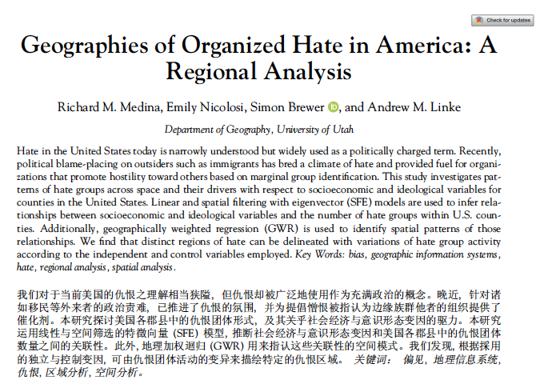
Geographic Determinants
Substance use clusters geographically and neighborhood characteristics, like income, correlate with rates of substance use disorders
Medina identifies “regions of hate” and posits that:
Less diversity + more poverty + less population change + less education = more hate groups
Notes:
--Substance use disorders and non-extremist violence cluster geographically, patterned by median income, inequality, and related indicators of neighborhood deprivation and stress*
--Similarly, hate groups show geographic patterning,** and extremist groups have their own logic for choosing sites for demonstrations, targeted recruitment, etc.
--Segregation and exposure to diversity drive radicalization and de-radicalization***
--A LOT MORE WORK TO DO HERE
*Molina, Kristine M., Margarita Alegría, and Chih-Nan Chen, "Neighborhood Context and Substance Use Disorders: A Comparative Analysis of Racial and Ethnic Groups in the United States," Drug and Alcohol Dependence, Vol. 125, Supp. 1, September 2012, pp. S35–S43.
**Goetz, Stephan J., Anil Rupasingha, and Scott Loveridge, "Social Capital, Religion, Wal-Mart, and Hate Groups in America," Social Science Quarterly, Vol. 93, No. 2, June 2012, pp. 379–393.
***Brown, Ryan Andrew, Todd C. Helmus, Rajeev Ramchand, Alina I. Palimaru, Sarah Weilant, Ashley L. Rhoades, and Liisa Hiatt, Violent Extremism in America: Interviews with Former Extremists and Their Families on Radicalization and Deradicalization, Santa Monica, Calif.: RAND Corporation, RR-A1071-1, 2021.

Slide 10
Implications for Prevention
and Deradicalization

Slide 11
Prevention: Early Intervention
Good Behavior Game, a 1st grade classroom intervention decreases substance abuse and violence in young adults
To decrease extremism, consider merging GBG with exposure to other races, ethnicities or religions
Or help those with early aggression decouple revenge motivations from a sense of justice
This Photo by Unknown Author is licensed under CC BY
Notes:
--Given the role of the pre-frontal cortex in self-regulation and in decreasing vengeful, impulsive behavior, interventions designed to increase pro-sociality and decrease impulsivity such as the Good Behavior Game (GBG) may be effective if implemented broadly and coupled with exposure to diversity*
--Similarly, interventions to decrease vengeful violence via decoupling revenge motivations from a sense of justice – such as the Nonjustice System (NJS) could be helpful for those showing early signs of aggression and vengeance**
*Kellam, Sheppard G., C. Hendricks Brown, Jeanne Poduska, Nicholas Ialongo, Wei Wang, Peter Toyinbo, Hanna Petras, Carla Ford, Amy Windham, and Holly C. Wilcox, "Effects of a Universal Classroom Behavior Management Program in First and Second Grades on Young Adult Behavioral, Psychiatric, and Social Outcomes," Drug and Alcohol Dependency, Vol. 95, Supp. 1, June 1, 2008, pp. S5–S28
**Rowe, M., Kimmel, J. Jr., Pavlo, A. J., Antunes, K.D., Bellamy, C.D., O'Connell, M.J., Ocasio, L., Desai, M., Bal, J., and Flanagan, E., “A Pilot Study of Motive Control to Reduce Vengeance Cravings,” Journal of the American Academy of Psychiatry and the Law 46, no. 4 (2018): 486-497

Slide 12
Prevention: Early Treatment
Externalizing symptoms (disruptive behaviors and hyperactivity) predict future substance use disorders with growing consensus to treat such symptoms early
Maybe we should treat mental health problems early in the hopes of preventing future violence and extremism
This Photo by Unknown Author is licensed under CC BY-SA
Notes:
--Given the role of the pre-frontal cortex in self-regulation and in decreasing vengeful, impulsive behavior, interventions designed to increase pro-sociality and decrease impulsivity such as the Good Behavior Game (GBG) may be effective if implemented broadly and coupled with exposure to diversity*
--Similarly, interventions to decrease vengeful violence via decoupling revenge motivations from a sense of justice – such as the Nonjustice System (NJS) could be helpful for those showing early signs of aggression and vengeance**

Slide 13
Prevention: Structural Factors
This Photo by Unknown Author is licensed under CC BY-SA-NC
If structural characteristics of neighborhoods can lead to substance use disorders, or possibly extremism, then maybe it is time to address those structural characteristics
Notes:
--Given the role of the pre-frontal cortex in self-regulation and in decreasing vengeful, impulsive behavior, interventions designed to increase pro-sociality and decrease impulsivity such as the Good Behavior Game (GBG) may be effective if implemented broadly and coupled with exposure to diversity*
--Similarly, interventions to decrease vengeful violence via decoupling revenge motivations from a sense of justice – such as the Nonjustice System (NJS) could be helpful for those showing early signs of aggression and vengeance**

Slide 14
Deradicalization: Change
Substance use counselors often use motivational interviewing techniques to help clients accept that they need to change
Therapists/family/friends may also help extremists recognize their own need for change
This Photo by Unknown Author is licensed under CC BY
Notes:
--Individual differences may play a role, and neural pathways can take a long time to extinguish; redirection into “replacement behaviors” may be helpful
Street violence to professional MMA
Propaganda and leadership to counter-extremism work
--Systematizing addiction and trauma-based approaches (Parents for Peace and 12-Step program)
--Destigmatizing, radical forgiveness, and lifetime support appear to be key in initiating and maintaining “sobriety from hate”

Slide 15
Deradicalization: Continuous Care
Substance use disorders often demand continuous care
May former extremists also need continuing care lest they relapse to hate
And they likewise need long-term support from family and friends and a network of like-minded individuals
This Photo by Unknown Author is licensed under CC BY-NC-ND
Notes:
--Individual differences may play a role, and neural pathways can take a long time to extinguish; redirection into “replacement behaviors” may be helpful
Street violence to professional MMA
Propaganda and leadership to counter-extremism work
--Systematizing addiction and trauma-based approaches (Parents for Peace and 12-Step program)
--Destigmatizing, radical forgiveness, and lifetime support appear to be key in initiating and maintaining “sobriety from hate”

Slide 16
Deradicalization: Radical forgiveness
Putative approaches that stigmatize marginalize those with substance use disorders / extremism often backfire
Instead, lets address these persistent and recalcitrant problems through community centeredness, harm reduction and radical forgiveness
Notes:
--Individual differences may play a role, and neural pathways can take a long time to extinguish; redirection into “replacement behaviors” may be helpful
Street violence to professional MMA
Propaganda and leadership to counter-extremism work
--Systematizing addiction and trauma-based approaches (Parents for Peace and 12-Step program)
--Destigmatizing, radical forgiveness, and lifetime support appear to be key in initiating and maintaining “sobriety from hate”

Slide 17
QUESTIONS & DISCUSSIO
N
Z
Thank you
Notes:
There are many other implications, of course, but I don’t have time to cover them all. I’d be happy to discuss them now in our Q and A session. Thank you.

